Slide 1

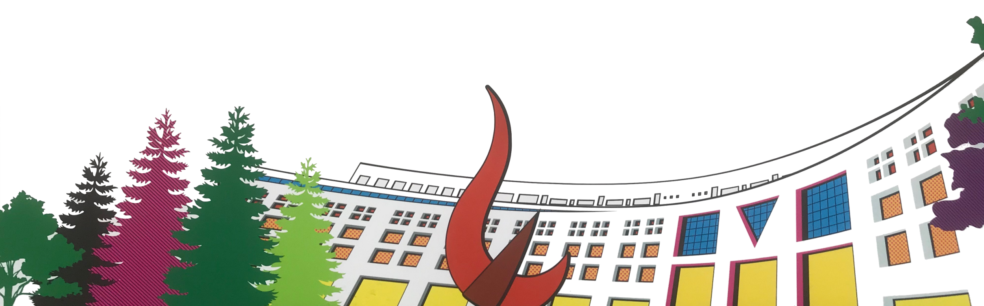

ML/DL for Everyone with
Lecture 3: Gradient Descent
Sung Kim <hunkim+ml@gmail.com> HKUST
Code: https://github.com/hunkim/PyTorchZeroToAll
Slides: http://bit.ly/PyTorchZeroAll
Videos: http://bit.ly/PyTorchVideo

Slide 2

Call for Comments
Please feel free to add comments directly on these slides.
Other slides: http://bit.ly/PyTorchZeroAll
Picture from http://www.tssablog.org/archives/3280

Slide 3
ML/DL for Everyone with
Lecture 3: Gradient Descent
Sung Kim <hunkim+ml@gmail.com> HKUST
Code: https://github.com/hunkim/PyTorchZeroToAll
Slides: http://bit.ly/PyTorchZeroAll
Videos: http://bit.ly/PyTorchVideo

Slide 4
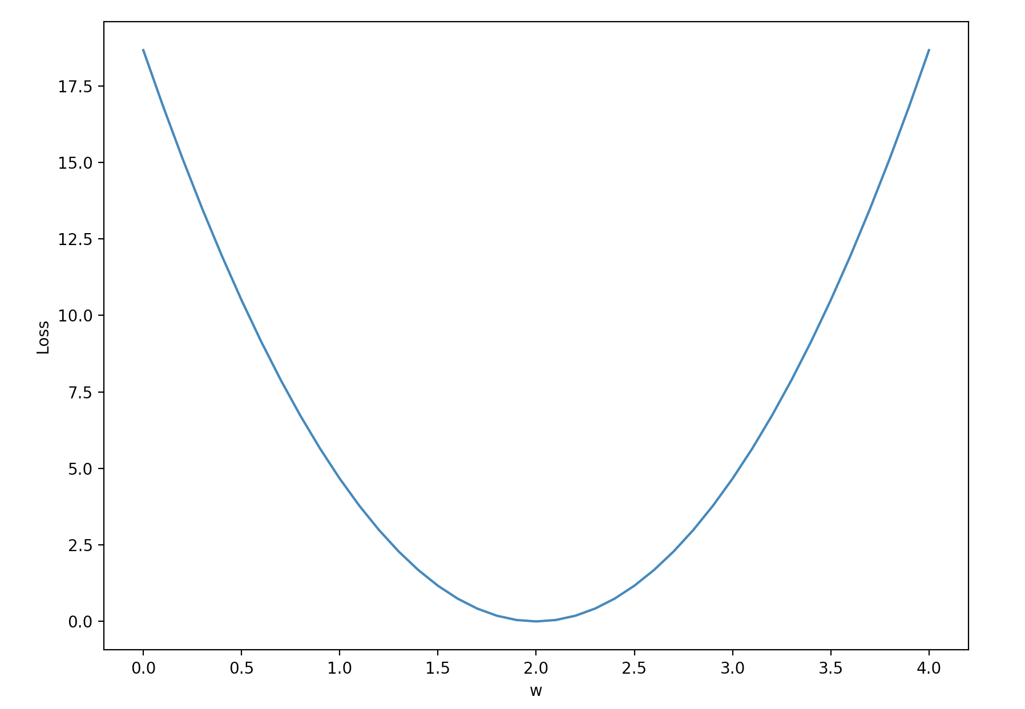
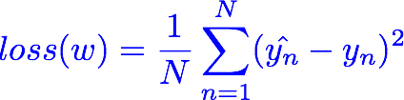
Loss graph
Loss (w=0) | Loss (w=1) | Loss (w=2) | Loss (w=3) | Loss (w=4)
mean=56/3=18.7 | mean=14/3=4.7 | mean=0 | mean=14/3=4.7 | mean=56/3=18.7
Notes:
loss = (\hat{y}-y)^2 = (x*w-y)^2

Slide 5
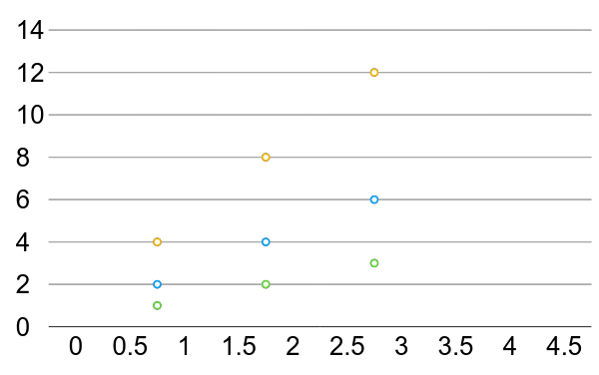
Linear Regression error?

Slide 6

What is the learning: find w that minimizes the loss
Loss (w=0) | Loss (w=1) | Loss (w=2) | Loss (w=3) | Loss (w=4)
mean=56/3=18.7 | mean=14/3=4.7 | mean=0 | mean=14/3=4.7 | mean=56/3=18.7
Notes:
loss = (\hat{y}-y)^2 = (x*w-y)^2

Slide 7
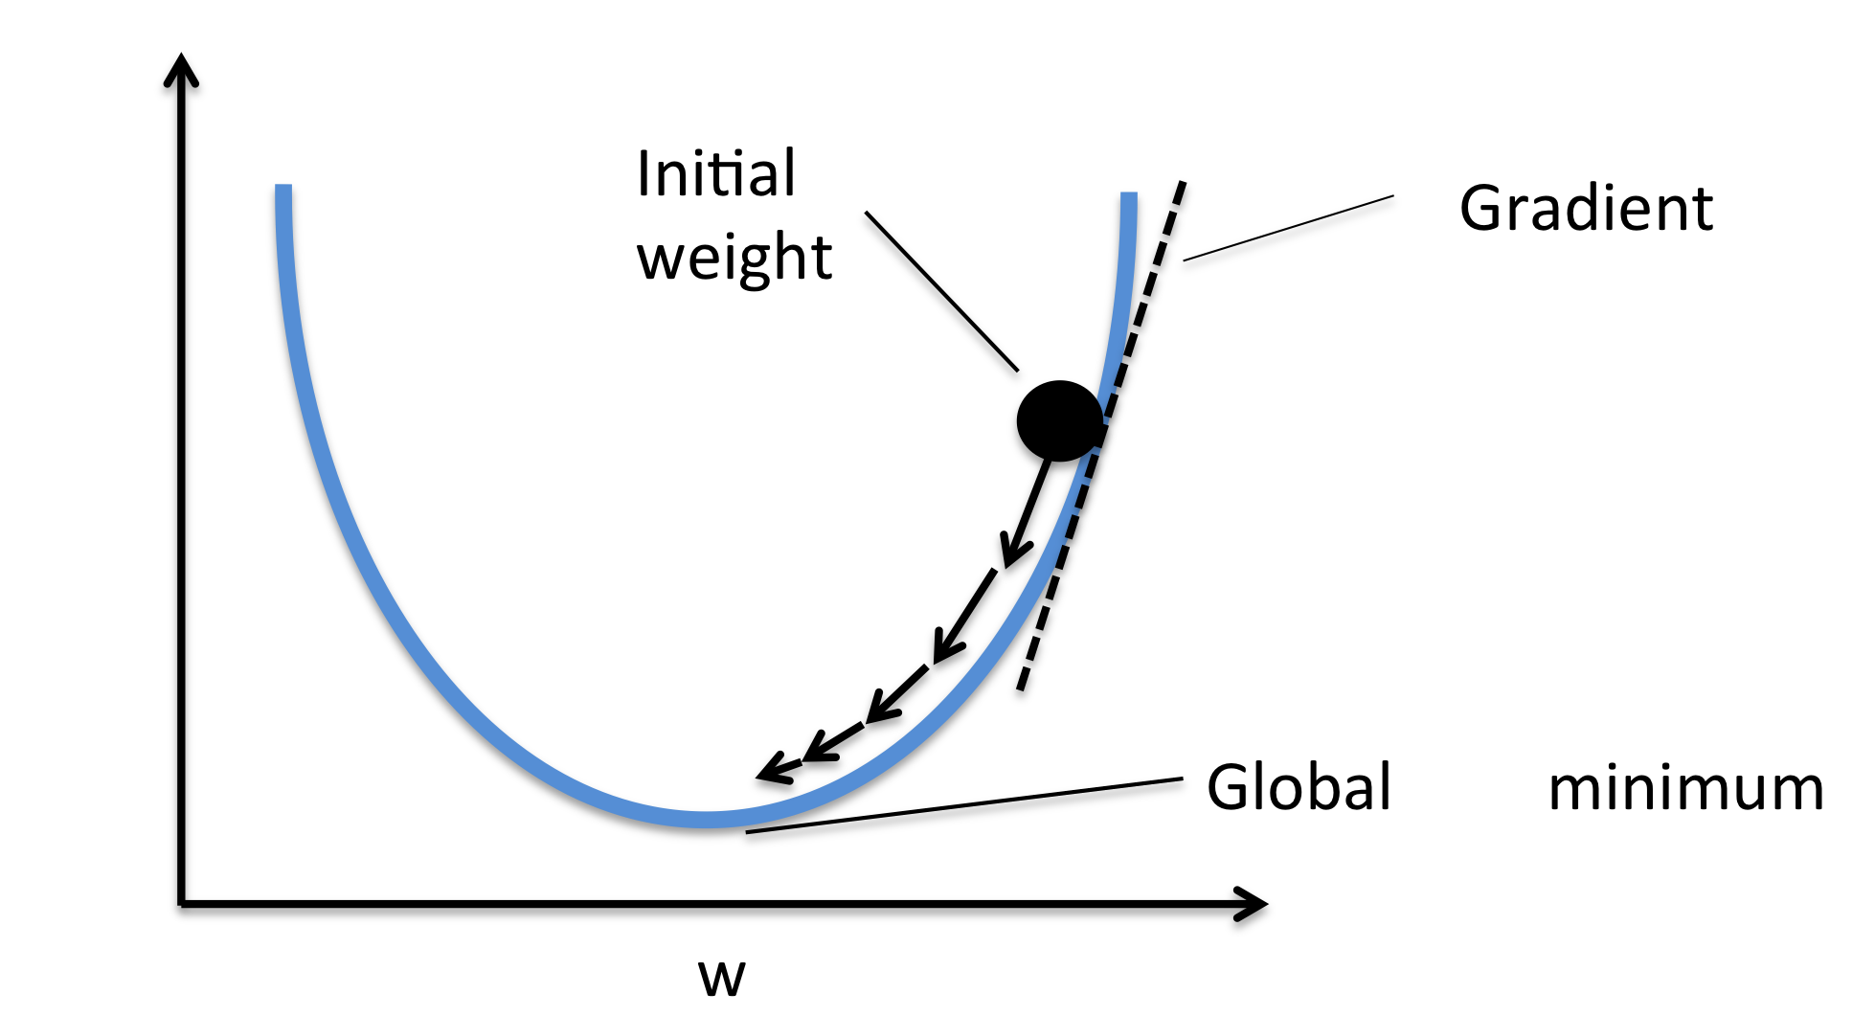

Gradient descent algorithm
loss
loss
Notes:
loss = (\hat{y}-y)^2 = (x*w-y)^2
\frac{\partial{loss}}{\partial{w}}=?

Slide 8


Gradient descent algorithm
loss
loss
Notes:
loss = (\hat{y}-y)^2 = (x*w-y)^2
\frac{\partial{loss}}{\partial{w}}=?

Slide 9
Derivative
Notes:
loss = (\hat{y}-y)^2 = (x*w-y)^2
\frac{\partial{loss}}{\partial{w}}=?

Slide 10

Derivative
Notes:
loss = (\hat{y}-y)^2 = (x*w-y)^2
\frac{\partial{loss}}{\partial{w}}=?

Slide 11
Derivative
Notes:
loss = (\hat{y}-y)^2 = (x*w-y)^2
\frac{\partial{loss}}{\partial{w}}=?

Slide 12
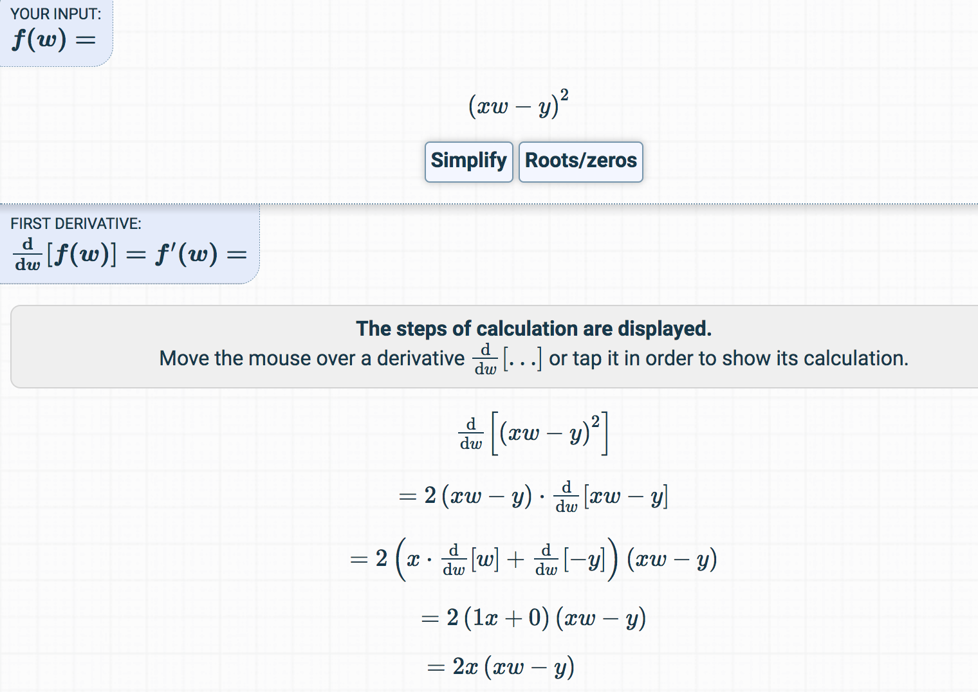
Derivative
https://www.derivative-calculator.net/
Notes:
loss = (\hat{y}-y)^2 = (x*w-y)^2
\frac{\partial{loss}}{\partial{w}}=?

Slide 13


Let’s implement!
loss
loss
Notes:
loss = (\hat{y}-y)^2 = (x*w-y)^2
\frac{\partial{loss}}{\partial{w}}=?

Slide 14

Data, Model, Loss, and Gradient
x_data = [1.0, 2.0, 3.0]
y_data = [2.0, 4.0, 6.0]
w = 1.0 # a random guess: random value
# our model forward pass
def forward(x):
return x * w
# Loss function
def loss(x, y):
y_pred = forward(x)
return (y_pred - y) * (y_pred - y)
# compute gradient
def gradient(x, y): # d_loss/d_w
return 2 * x * (x * w - y)
Notes:
=w-\alpha*2x(xw-y)

Slide 15
Training: updating weight
x_data = [1.0, 2.0, 3.0]
y_data = [2.0, 4.0, 6.0]
w = 1.0 # a random guess: random value
# our model forward pass
def forward(x):
return x * w
# Loss function
def loss(x, y):
y_pred = forward(x)
return (y_pred - y) * (y_pred - y)
# compute gradient
def gradient(x, y): # d_loss/d_w
return 2 * x * (x * w - y)
# Before training
print("predict (before training)", 4, forward(4))
# Training loop
for epoch in range(100):
for x_val, y_val in zip(x_data, y_data):
grad = gradient(x_val, y_val)
w = w - 0.01 * grad
print("\tgrad: ", x_val, y_val, grad)
l = loss(x_val, y_val)
print("progress:", epoch, "w=", w, "loss=", l)
# After training
print("predict (after training)", "4 hours", forward(4))

Slide 16
Output
(from gradient numeric computation)
predict (before training) 4 4.0
grad: 1.0 2.0 -2.0
grad: 2.0 4.0 -7.84
grad: 3.0 6.0 -16.23
progress: 0 w= 1.26 loss= 4.92
grad: 1.0 2.0 -1.48
grad: 2.0 4.0 -5.8
grad: 3.0 6.0 -12.0
progress: 1 w= 1.45 loss= 2.69
grad: 1.0 2.0 -1.09
grad: 2.0 4.0 -4.29
grad: 3.0 6.0 -8.87
progress: 2 w= 1.6 loss= 1.47
grad: 1.0 2.0 -0.81
grad: 2.0 4.0 -3.17
grad: 3.0 6.0 -6.56
..
progress: 7 w= 1.91 loss= 0.07
grad: 1.0 2.0 -0.18
grad: 2.0 4.0 -0.7
grad: 3.0 6.0 -1.45
progress: 8 w= 1.93 loss= 0.04
grad: 1.0 2.0 -0.13
grad: 2.0 4.0 -0.52
grad: 3.0 6.0 -1.07
progress: 9 w= 1.95 loss= 0.02
predict (after training) 4 hours 7.80
# Before training
print("predict (before training)", 4, forward(4))
# Training loop
for epoch in range(100):
for x_val, y_val in zip(x_data, y_data):
grad = gradient(x_val, y_val)
w = w - 0.01 * grad
print("\tgrad: ", x_val, y_val, grad)
l = loss(x_val, y_val)
print("progress:", epoch, "w=", w, "loss=", l)
# After training
print("predict (after training)", "4 hours", forward(4))

Slide 17
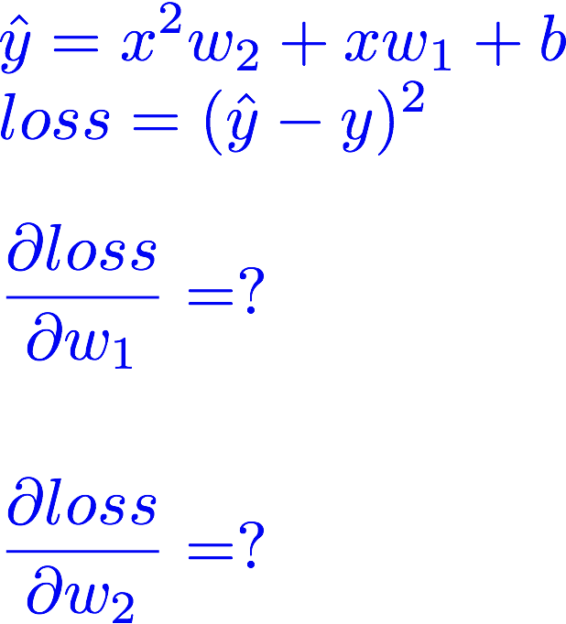
Exercise 3-1: compute gradient

Slide 18
Exercise 3-2: implement

Slide 19


Lecture 4:
Back-propagation

